Slide 1
Case study
Trauma
Here is where your presentation begins

Slide 2
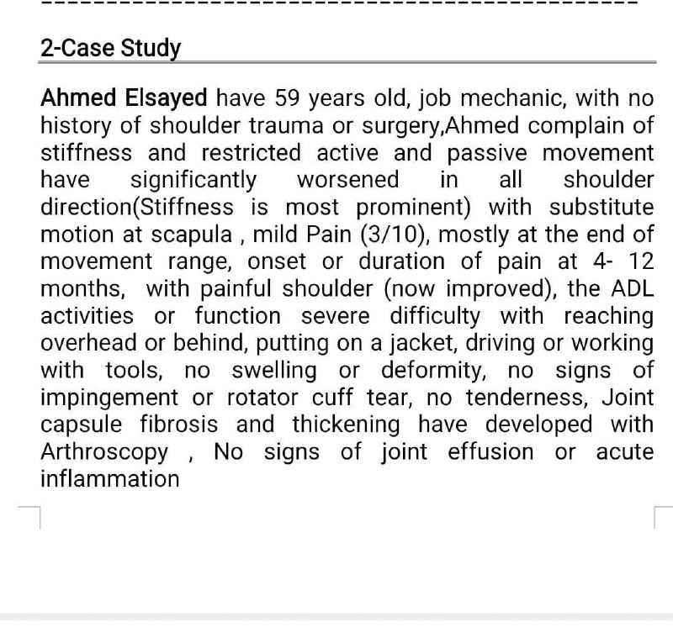
Case :

Slide 3
History
1-personal history
Name :Ahmed Elsayed
Age: 59
Sex :Male
occupation: mechanic.

Slide 4
Diagnose
Adhesive Capsulitis (Frozen Shoulder) – Stage 2 (Fibrotic Phase)
Chief Complain
Severe shoulder stiffness limiting daily activities (overhead reach, dressing, driving, work)

Slide 5
PRESENT HISTORY
1. Onset of Symptoms:
- Gradual onset no specific traumatic event
- Initial symptoms: Shoulder stiffness with mild pain (3/10).
2. Duration of Symptoms:
- 4–12 months (chronic stage).
3. Course of Symptoms:
- Progressive worsening of stiffness and restricted movement.
- Initially painful shoulder, but pain has improved over time.
- Now severe functional limitation (difficulty with overhead activities, dressing, driving, work tasks).
4. Mechanism of Injury:
- No history of trauma (non-traumatic onset).

Slide 6
5. Diagnostic Imaging / Laboratory Tests:
- Arthroscopy findings:
- Joint capsule fibrosis and thickening.
- No joint effusion or acute inflammation.
- No signs of rotator cuff tear, impingement, or structural deformity.
6. Previous Treatment (Medical/Physical Therapy):
- No prior surgery or injections reported.
7. Special Precautions:
- Avoid aggressive mobilization if severe fibrosis (risk of micro-tears).
- Monitor for increased pain or inflammation

Slide 7
PAIN HISTORY
1. Quality: Pulling (at end-range movements)
. Aggravating Factors:
- Extreme shoulder movements (reaching overhead, behind the back).
- Functional activities (putting on a jacket, driving, using tools)
Mild, intermittent dull ache (3/10)

Slide 8
Assessment:
- Stage 2 Adhesive Capsulitis (fibrotic phase with capsular thickening).
- Severe functional impairment (ADLs and work-related tasks affected).
- No signs of rotator cuff pathology, impingement, or inflammation.

Slide 9
Problem List:
1. Severe restricted shoulder ROM (global limitation in flexion, abduction, IR/ER).
2. Scapulothoracic compensatory movements (due to glenohumeral stiffness).
3. Mild end-range pain (3/10).
4. Functional deficits (overhead reach, dressing, driving, tool use)
.
5. Capsular fibrosis

Slide 10
Aim of Treatment:
1. Restore shoulder mobility
2. Improve functional independence (ADLs, work tasks).
3. Reduce scapular substitution patterns.
4. Manage pain

Slide 11
Plan of Treatment:
1Aggressive stretching (capsular-specific techniques):
2Posterior capsule stretch (cross-body adduction, sleeper stretch)
3 Inferior capsule stretch (elevation with scapular stabilization).
External rotation (ER) / Internal rotation (IR)
4mobilization
Joint mobilizations (Grade III/IV for end-range capsular restriction
5 Scapular stabilization exercises
6Progressive AAROM/ROM exercises (wand, pulley, wall climbs).
- Home exercise program (consistent daily stretching).

Slide 12
2. Pain Management
Heat therapy improve tissue elasticity
NSAIDs only if pain interferes with rehab
Non Physiotherapy managment
3. Advanced Interventions (if conservative treatment fails):
- Hydrodilatation
- Manipulation Under Anesthesia
- Arthroscopic capsular release
4. Functional & Occupational Reintegration:
Task-specific training
Ergonomic modifications

Slide 13
*Role of regulatory authorities:
Important role in preventing medication errors .
Review of drug labels & nomenclature greatly enhances preventive strategies.
FDA provides guidance to industry to maintain proper drug labels .
FDA reviews 300 brand names in a year before they are marketed to avoid confusion of LASA drugs .
Potentially confusing names rejected .
FDA encourages pharmacists & other health professional to report any medication errors .

